Slide 1
Computer Architecture Concepts
Part 6 – Data Representation – Text

Slide 2
Objectives
To understand
How binary data can be used to represent text

Slide 3
Character codes
A character is an individual element of text and could be
Any key you could key on your keyboard – including numbers, letters, punctuation, special characters like Enter, Delete, Space etc.
A character could also be a more complex item like characters from languages other than English, special symbols, emojis
As computers store everything as binary, each character needs a unique binary representation – a character code
The character codes have to be agreed so that text can be exchanged between computers

Slide 4
ASCII
American Standard Code for Information Interchange
Originally developed in the 1960s
Gives a 7-bit code for:
Control characters
Escape, Delete, Backspace, New Line etc
Some no longer used like Acknowledgement, Bell
Printable characters
Letters used in English (upper and lower case)
Digits
Punctuation marks

Slide 5
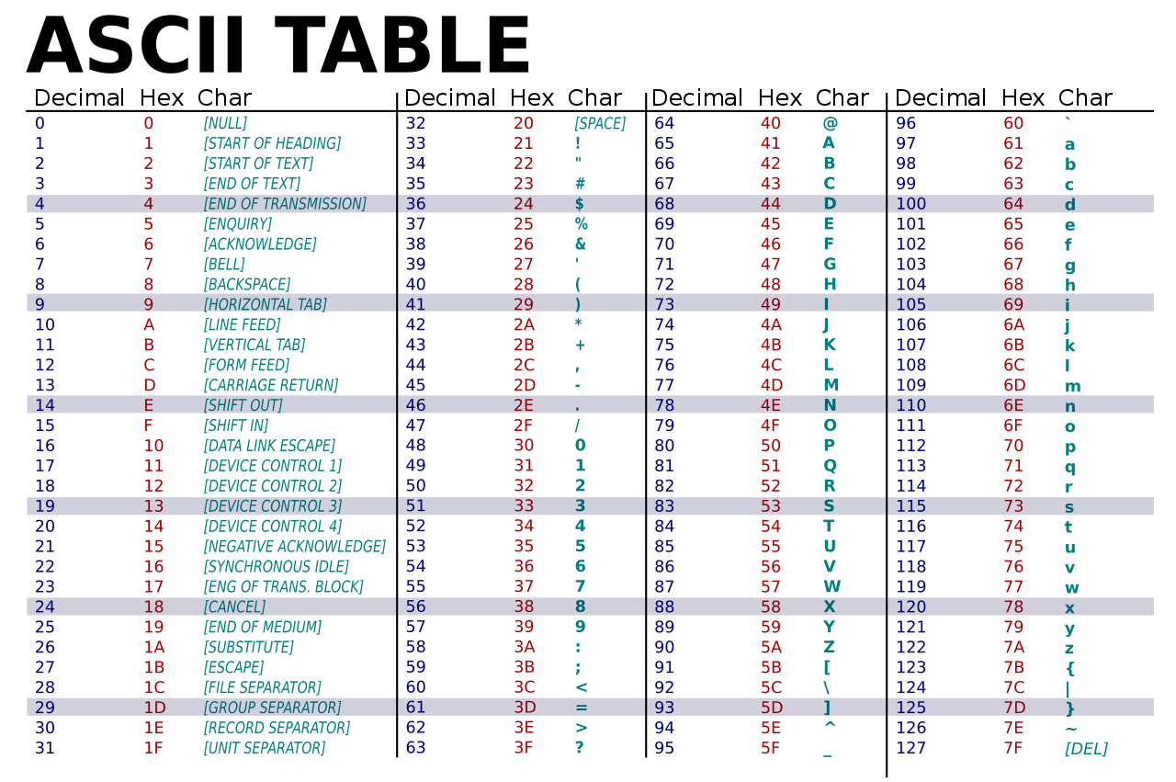
ASCII table

Slide 6
Summary
Although ASCII has limitations, it is still used as the basis for other character sets

